Slide 1
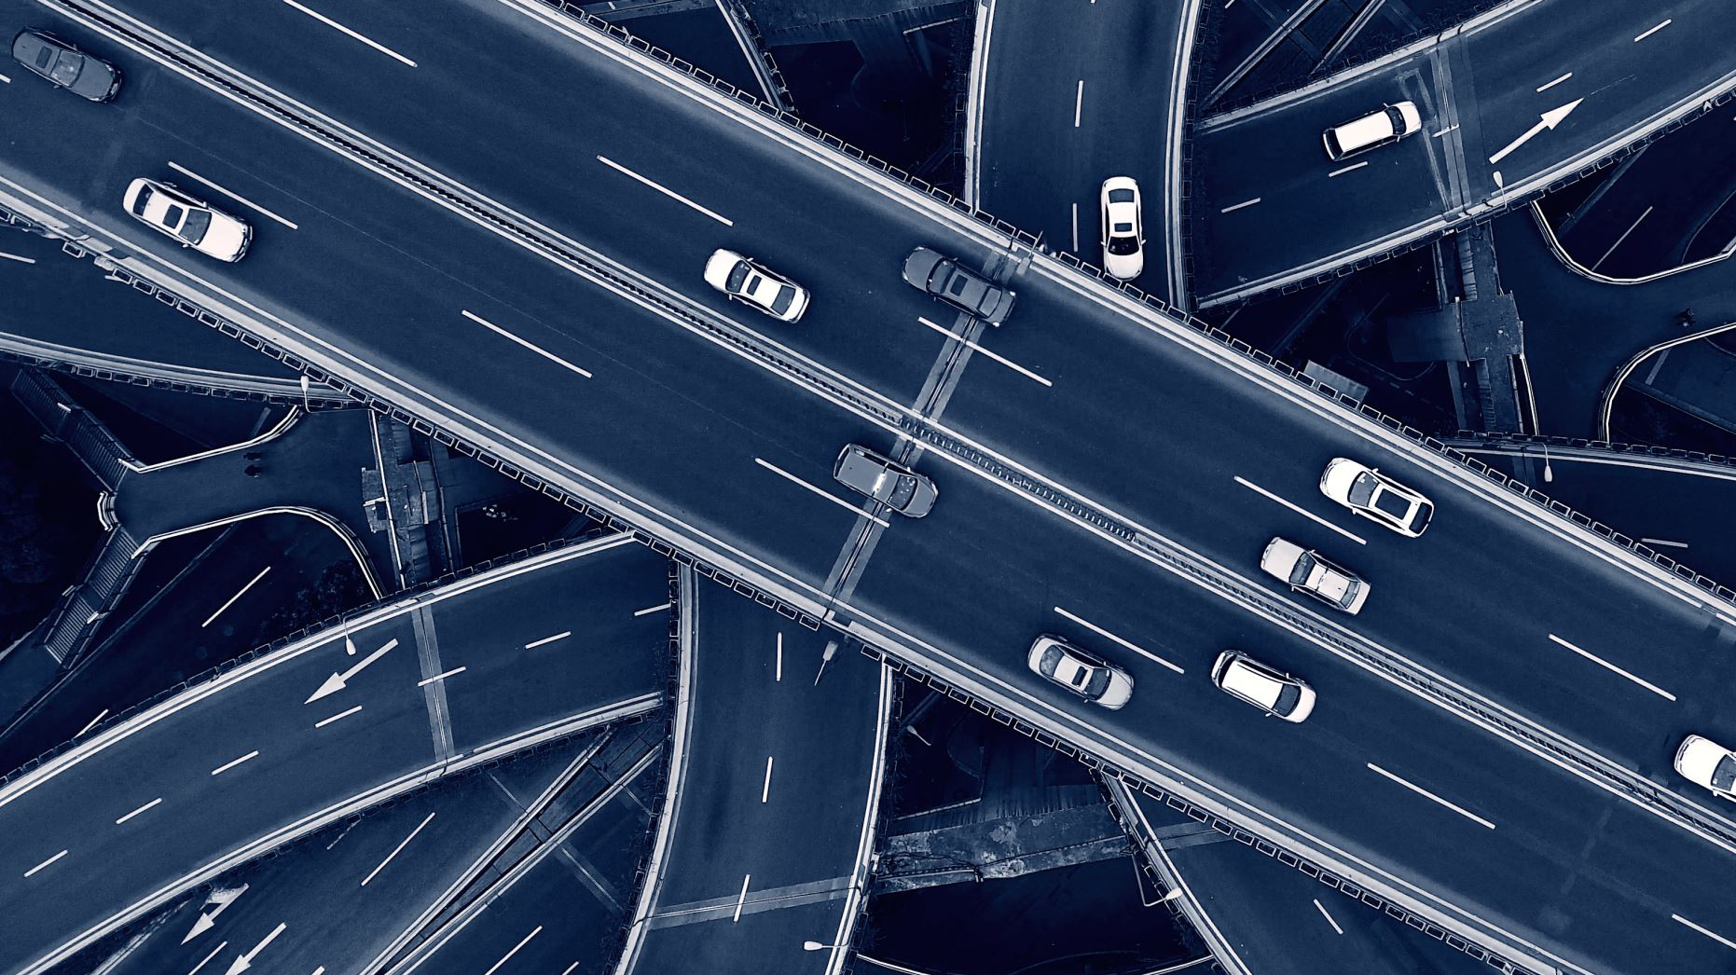
Car Plate Number Detector
Sanjana Panda

Slide 2
Problem Statement
Car Rento, a car renting company is looking for a solution to recognize car plate number from images.
They want to add a new verification process in their app, wherein the customer uploads images of the car before and after a ride. One of the steps in the verification would be identifying the car plate number from the image.
Hence, aim of this project is to build a model that would extract car plate number from images.

Slide 3
Data
Data was collected from Kaggle.
Around 450 images were used for building the model.
Along with images, corresponding annotation files is also present.
Approach
This problem can be divided into two parts:
1. Detecting car plate from images. For which transfer learning on a TensorFlow’s Object Detection model (ssd mobinet model) is used.
2. After detecting the car plate, extract text within the region. Character Recognition is done using OCRopus and Tesseract.

Slide 4
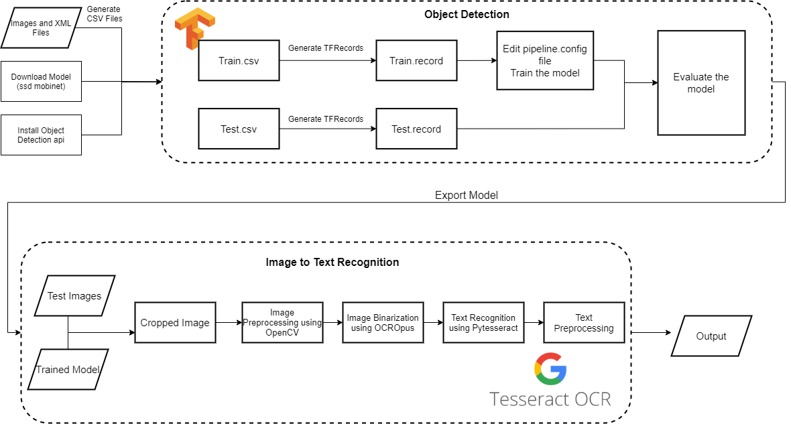
Architecture

Slide 5
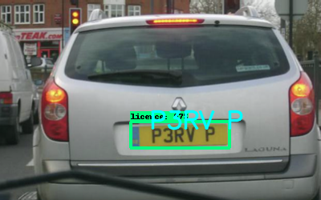
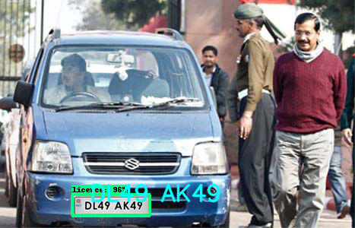
Result
Object Detection
mAP: 0.493867
mAR: 0.549057
Text Recognition
Label | Count
Match | 14
Close Match | 13
Not Match | 17
No plate detected | 6
Total | 50

Slide 6
Future Improvement
The threshold is set higher i.e., 0.6 because even if plates are detected. Because with lower threshold, images detected are highly pixelated.
Some characters are getting jumbled e.g., '8' and 'B’.
Many a times images or interference within the plates, don't help getting results.
Adding rules to preprocessing extracted texts for images.

